Slide 2
Important ATI Legal Notice and Permitted Uses

Slide 3
Alterations in Cardiovascular Function and Perfusion

Slide 4
Review Activities
Navigate to Review Modules. Open Adult Medical Surgical Nursing and review the following (45 min):
  Chapter 28 Cardiovascular Diagnostic and Therapeutic Procedures
  Chapter 29 Electrocardiography and Dysrhythmia Monitoring
  Chapter 30 Pacemakers and Automatic Internal Cardiac Defibrillator
  Chapter 31 Invasive Cardiac Procedures
  Chapter 32 Angina and Myocardial Infarction
  Chapter 33 Heart Failure and Pulmonary Edema
  Chapter 34 Valvular Heart Disease
  Chapter 35 Inflammatory Disorders
  Chapter 36 Peripheral Vascular Diseases
Navigate to Pharmacology Made Easy. Open The Cardiovascular System and review the following (15 min):
  The anatomy and physiology of the cardiovascular system in the Introduction section.
Navigate to HealthAssess and complete the following modules (3 hr):
  Cardiovascular learning module + Virtual Application: Doris Anderson
  Virtual Clinical Experience: Cardiovascular: Heart Failure (Harold Stevens)
Navigate to Video Case Studies and complete the following case studies:
  Perfusion: Cardiac Cath With Stent (20 min)
  Fluid & Electrolyte Balance: Heart Failure (20 min)
Complete active learning templates for the following medications (70 min):
  Adenosine
  Amiodarone
  Atropine
  Metoprolol
  Digoxin
  Diltiazem
  Heparin infusion
Navigate to Real Life Medical Surgical. Open Myocardial Infarction Complications and complete the scenario (60 min).
Notes:
Faculty note:
These are recommendations for potential pre-work. They are other ATI products and modules that align with the lesson’s content.
Suggested time frames to complete the additional activities are also listed.

Slide 5
Learning Objectives
Explain the pathophysiology for alterations in cardiovascular function and perfusion.
Explore epidemiological and etiological risk factors that contribute to clients experiencing alterations in cardiovascular function and perfusion.
Describe the impact of alteration in cardiovascular function and perfusion on a client’s overall health.
Differentiate the clinical presentation of clients experiencing alterations in cardiovascular function and perfusion.
Explore the role of the nurse when caring for clients experiencing alterations in cardiovascular function and perfusion.
Apply nursing process through use of the clinical judgment functions while providing care to clients experiencing alterations in cardiovascular function and perfusion.
Notes:
Faculty note:
Review learning outcomes to be obtained by the end of the lesson.
To access the full reference list, go to the Summary section within the module.

Slide 6
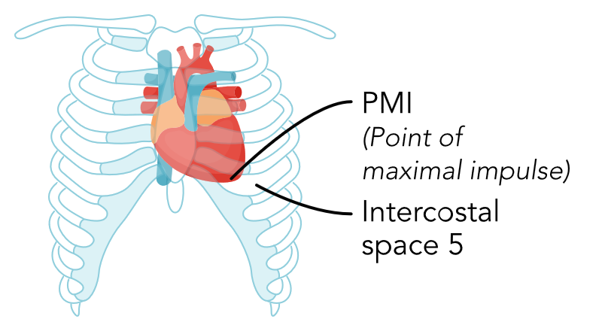
Anatomy and Physiology of the
Cardiovascular System (1 of 10)
Location of heart
  Lies in the mediastinum
  Extends downward and to the left
Point of maximal impulse
  Apex of the heart
  5th intercostal space
  Midclavicular line
Notes:
Faculty note:
The Anatomy and Physiology should be a brief review
Function of the heart: pumps oxygenated blood and nutrients to the rest of the body, receives deoxygenated blood, and pumps away unwanted waste products. The heart also maintains the heart rate and blood pressure.

Slide 7
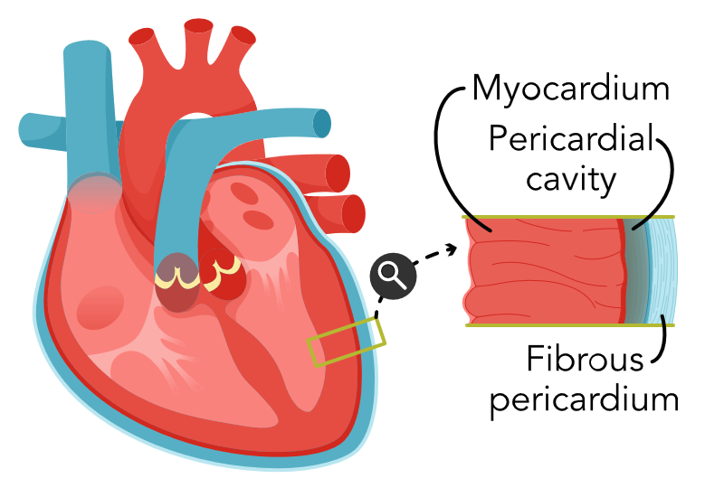
Anatomy and Physiology of the
Cardiovascular System (2 of 10)
3 Layers of tissue
  Endocardium
    Lining of heart and heart valves
  Myocardium
    Muscle for pumping
  Epicardium
    Serous layer: protects the heart
Pericardium: Sac surrounding heart
  Visceral pericardium: covers heart surface
  Parietal pericardium: lining of pericardial sac
Notes:
Faculty note:
The parietal pericardium surrounds the visceral pericardium and attaches to the great vessels, the diaphragm, the sternum, and the vertebral column allowing the heart to be anchored in the thorax. The pericardial space contains serous fluid that allows the visceral and parietal pericardium to smoothly move against each other.

Slide 8
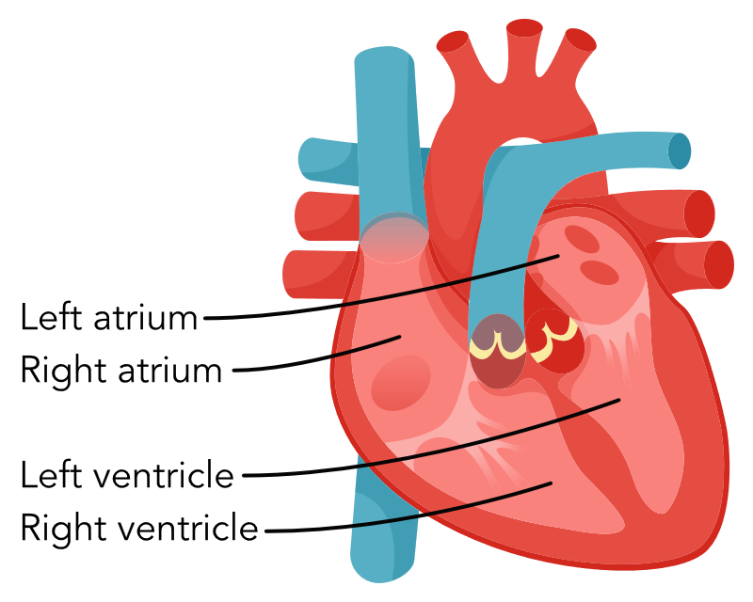
Anatomy and Physiology of the
Cardiovascular System (3 of 10)
Heart chambers
  Atria: Receives blood returning from body and lungs
  Ventricles: Pumps blood to the body and lungs
Septum
  Separates right and left side of heart

Slide 9
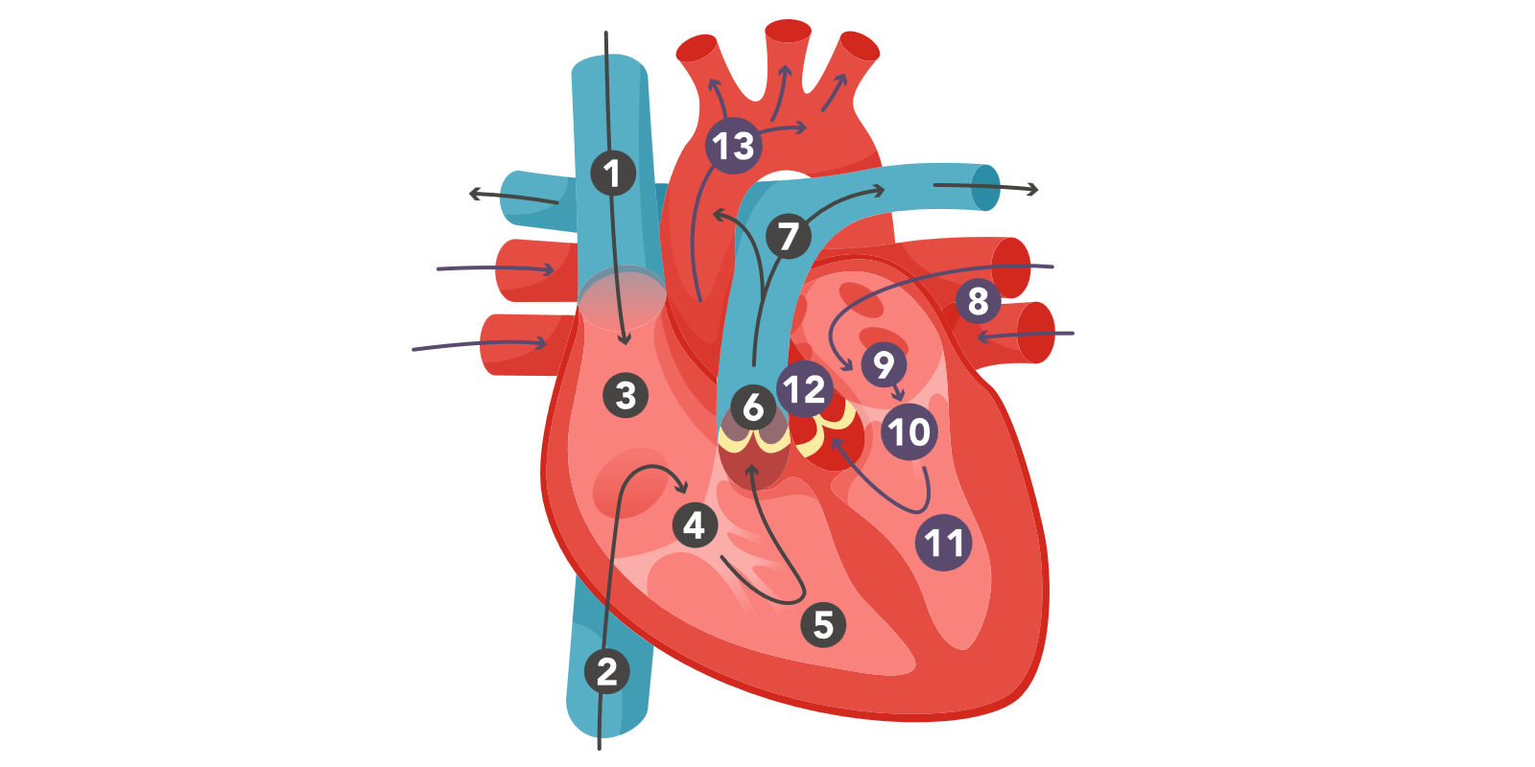
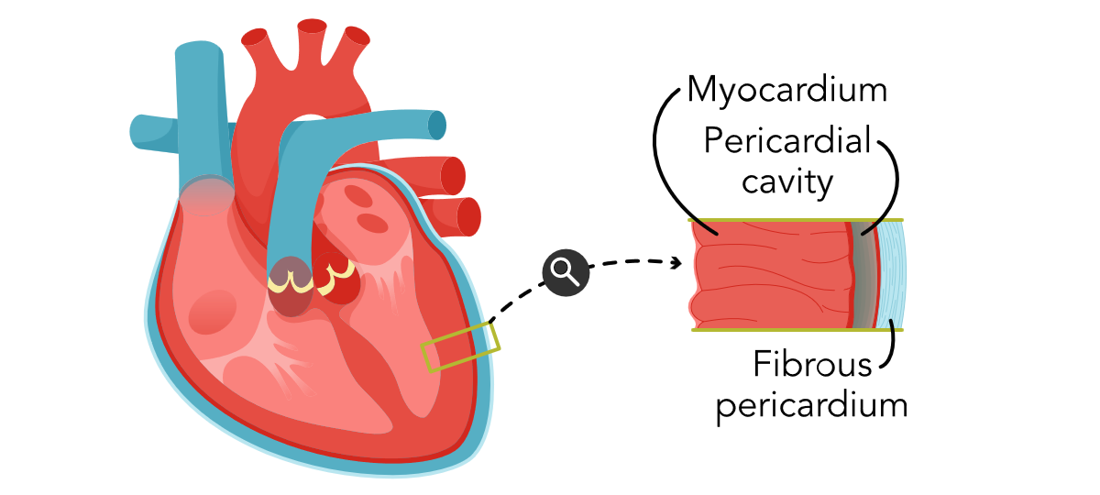
Anatomy and Physiology of the Cardiovascular System (4 of 10)
Notes:
Faculty note:
Flow of blood through the heart:
Deoxygenated blood from the head and neck flows through the superior vena cava to the right atrium
Deoxygenated blood from the rest of the body flows through the inferior vena cava also to the right atrium
Ventricular systole: Right atrium delivers blood through the tricuspid valve to the right ventricle
Right ventricle pumps blood through the pulmonary valve to right and left pulmonary arteries and to the lungs.
Blood is oxygenated in the lungs
Systole: Oxygenated blood returns to the left atrium through the pulmonary veins
Diastole: Left atrium delivers blood through the mitral valve (also called bicuspid valve) to the left ventricle
Left ventricle pumps blood through the aortic valve to the aorta and out to the body.
The Tricuspid, mitral, and pulmonary valves are essentially one way doors for blood to flow through.

Slide 10
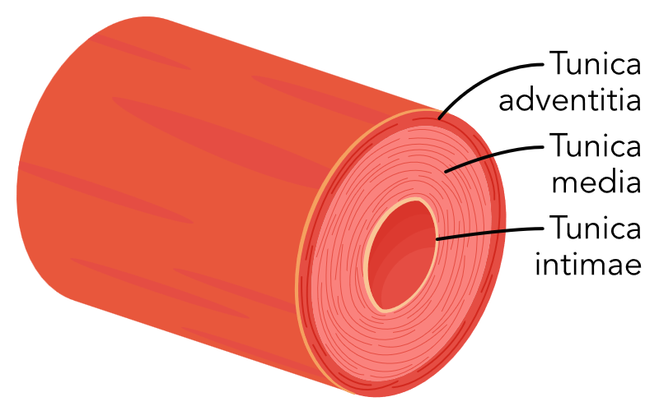
Anatomy and Physiology of the
Cardiovascular System (5 of 10)
Vascular System
  Arterial system
    Arteries: High pressure blood is transported from the heart to arteries and arterioles
    Arterioles: Join arteries and capillaries
  Venous system
    Veins: Act as a reservoir of blood and carries low-pressure blood to the heart from venules
    Venules: Joins capillaries and veins
  Capillaries: Permits gas exchange, the transfer of nutrients and the removal of waste between blood and the fluid of tissues

Slide 11
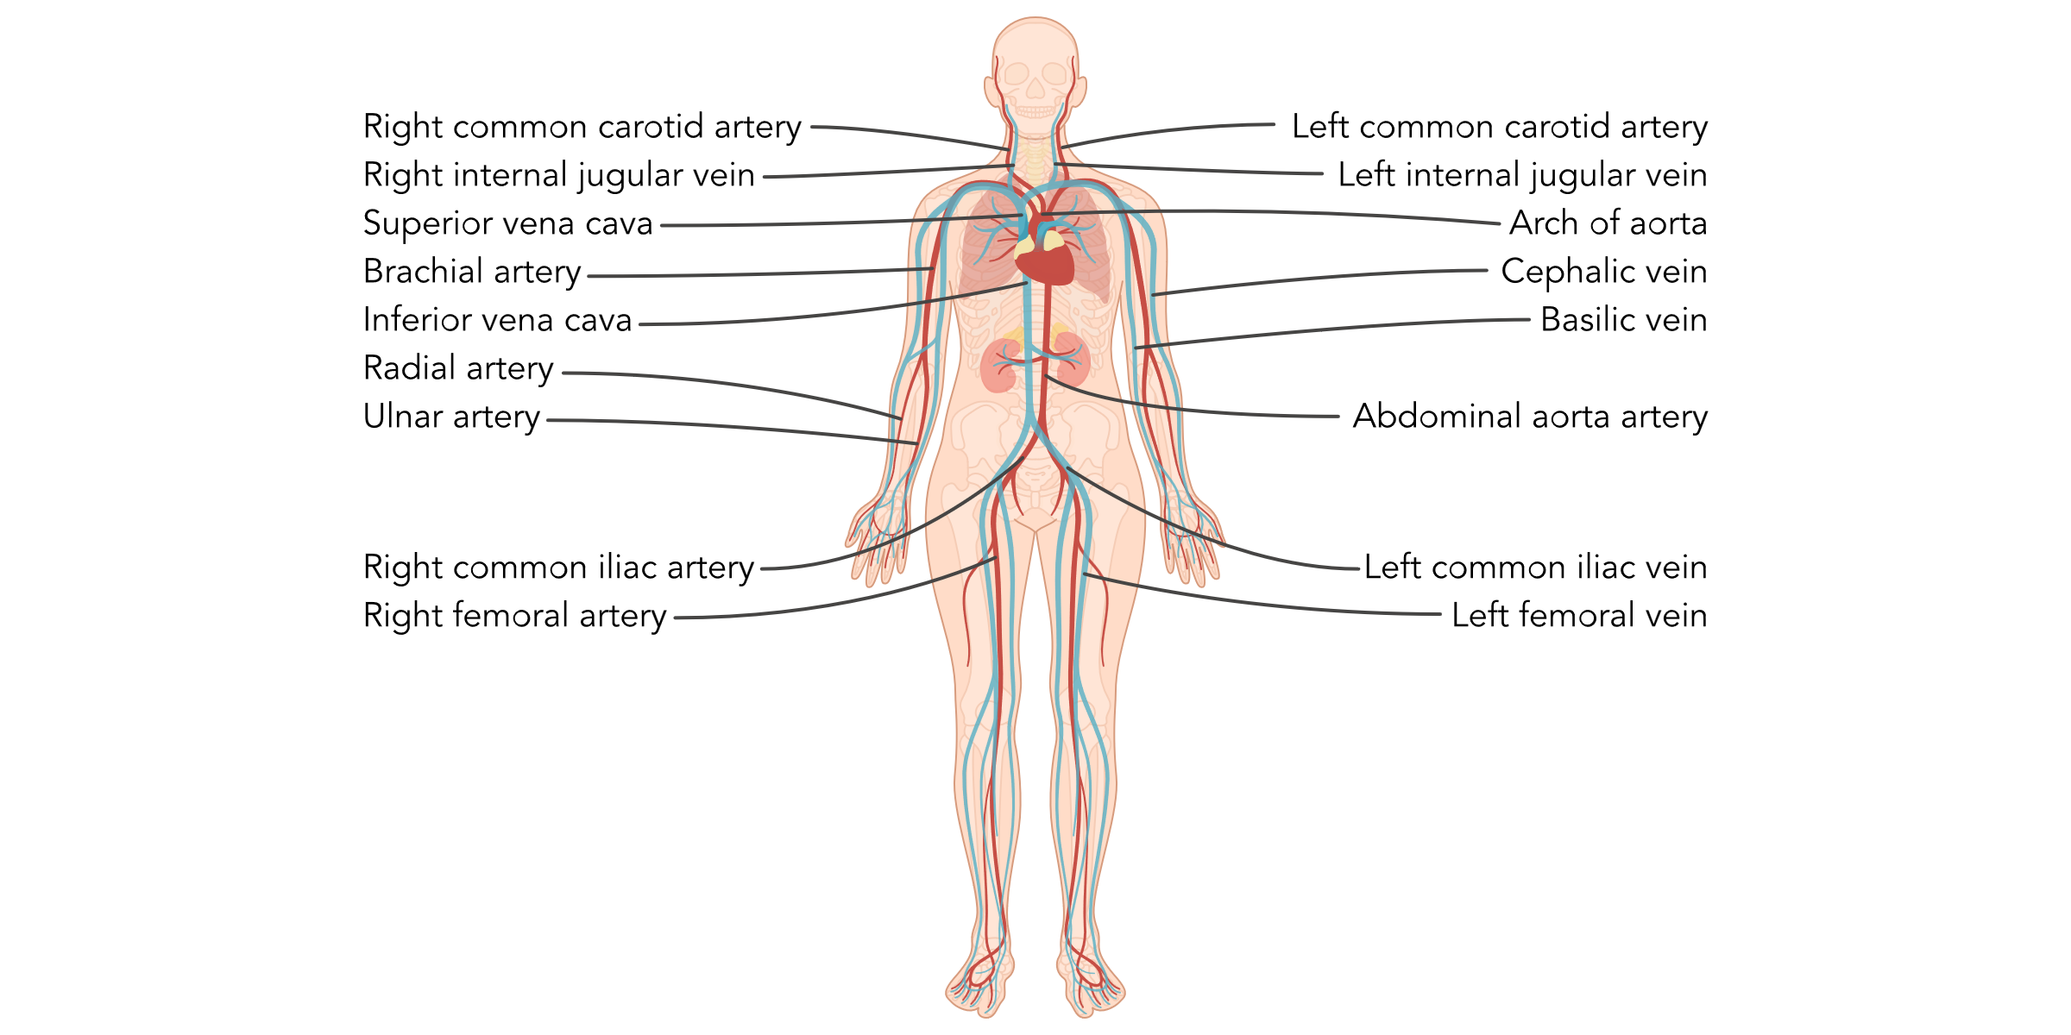
Anatomy and Physiology of the
Cardiovascular System (6 of 10)
Notes:
Faculty note:
Major arteries and veins in the body

Slide 12
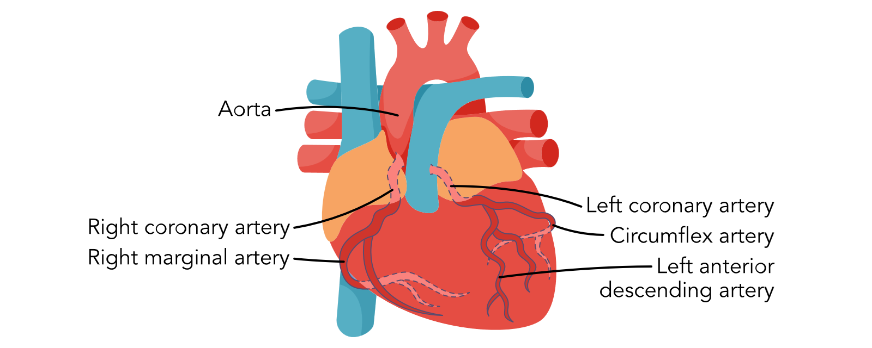
Anatomy and Physiology of the
Cardiovascular System (7 of 10)
Notes:
Faculty note:
Coronary arteries originate from the base of the aorta just above the aortic valve.
Right and left coronary arteries deliver oxygenated blood to the body during diastole.
Slower heart rates result in a longer period of diastole allowing more time for coronary perfusion to occur.
Left coronary artery has 3 branches: all supply blood to different areas of the left side of the heart
Left main coronary artery
Left anterior descending artery
Circumflex artery
Right coronary artery has 2 branches
Marginal artery
Posterior descending artery

Slide 13
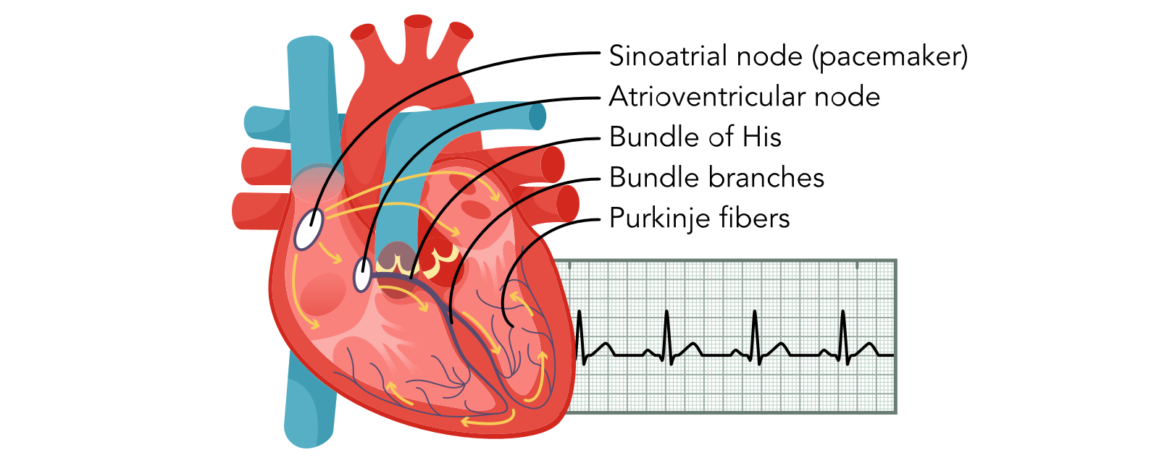
Anatomy and Physiology of the
Cardiovascular System (8 of 10)
Notes:
Faculty note:
The heart has its own conduction system that generates and transits electrical impulses that stimulate the contraction of the myocardium.
Sinoatrial (SA) node: cardiac impulses start in SA node. Located in right atrium. Considered the heart’s natural pacemaker because it sets the rate and rhythm of the heart.
From the SA node the heart sends the impulse through the atria, causing the atria to contract. The impulse then travels to the AV node.
Atrioventricular (AV) node: a slight delay of the impulse in the AV node allows the atria to fully contract and empty into the ventricles.
The impulse travels to the Bundle of His which divides into the right and left ventricle respectively.
The impulse continues along the Purkinjie fibers reaching the terminal point in the conduction system and ventricular contraction occurs.
Abnormal heart rhythms (dysrhythmias) can occur when there is disease or dysfunction in the normal conduction pathway.

Slide 14
Anatomy and Physiology of the
Cardiovascular System (9 of 10)
Atria and Ventricles contract and relax in an organized fashion.
  2 phased cardiac cycle (one heartbeat “lub-dub”)
    Systole: the contraction phase
    Diastole: the relaxation phase
Cardiac Output: total amount of blood ejected from one ventricle of the heart in L/min.
Normal cardiac output in a healthy adult at rest is 5 to 6 L/min.

Slide 15
Anatomy and Physiology of the
Cardiovascular System: Discussion Question
Cardiac output is the amount of blood that ejected from one ventricle in L/min.
  What factors can you think of that would affect cardiac output?
Notes:
Faculty note:
Factors that affect cardiac output: vasoconstriction, the compliance of arteries, arterial pressure, the amount of volume of blood entering the heart from the veins, and exercise..

Slide 16
Anatomy and Physiology of the
Cardiovascular System (10 of 10)
To calculate cardiac output:
  Stroke Volume times heart rate
Stroke Volume: the volume of blood ejected by one ventricle per heartbeat.
Three factors determine stroke volume
  Preload: the degree of stretching of the ventricular muscle when the heart is at the end of diastole.
  Afterload: the resistance or pressure that the ventricle needs to overcome to eject the blood into the peripheral circulation during ventricular contraction.
  Contractility: the force that the myocardium generates during contraction.
Notes:
Faculty note:
Preload: the volume of blood is the highest in the ventricle at the end of diastole, meaning the stretch of the muscle fibers is the greatest. The volume of the blood in the ventricle at the end of diastole determines preload, which affects stroke volume.
Afterload: Resistance is directly related to arterial blood pressure and the diameter of the blood vessels. Smaller blood vessels increase afterload (client with hypertension).
Contractility: The contractility of the heart can be affected by multiple factors. Sympathetic stimulation or positive inotropic medications may cause contractions to increase, or hypoxia and negative inotropic medications could cause contractions to decrease.

Slide 17
Heart Sounds
The cardiac cycle generates 2 heart sounds with each heartbeat audible with a stethoscope (Lub Dub)
S1: the first heart sound heard indicates the closure of the mitral and tricuspid valves (Lub)
S2: the second heart sound signifies the closure of the aortic and pulmonic valves (Dub)
S3 and S4 are abnormal heart sounds.
Murmurs: indicate turbulent blood flow through normal or abnormal valves. (Whooshing sound)
Pericardial friction rub: an abnormal heart sound that is typically heard over the left sternal boarder. (Grating sound)
Notes:
Faculty note:
Heart sounds that are auscultated correlate with the closure of the heart valves and are considered normal heart sounds.
S3 and S4 best heard with the bell of the stethoscope.
S3 can be normal in children and adults up to age 40. In adults older than 40, a s3 could indicate heart failure and decreased ventricular compliance. S3 is a ventricular gallop and is heard as a loud DUB following S2.
S4 is described as an atrial gallop and is heard as a loud LUB immediately before S1 and is also due to decrease ventricular compliance caused by hypertension, aortic stenosis, coronary artery disease or cardiomyopathy.
Murmurs: Murmurs are classified according to their timing in the cardiac cycle. Systolic murmurs occur between S1 and S2. Diastolic murmurs will be auscultated between S2 and S1.
Pericardial friction rub: occurs due to inflammation, infection, or infiltration in the pericardial sac. Pericardial friction rubs are transient and once the causative factor is treated, the friction rub is no longer auscultated.

Slide 18
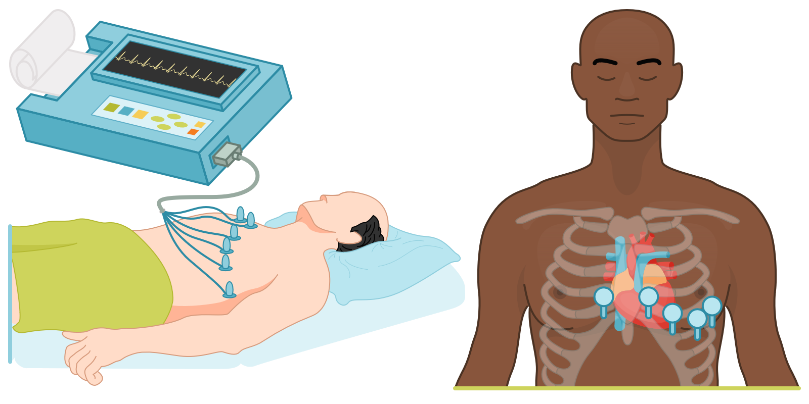
Cardiac Rhythms (1 of 5)
Electrocardiogram
  Records cardiac electrical activity
    Depolarization: the electrical impulse that activates the heart to contract
    Repolarization: The heart muscle relaxes
Notes:
Faculty note:
An ECG does not visualize actual cardiac structures but will identify areas in the heart that are experiencing a decrease or absence of adequate blood flow or perfusion.

Slide 19
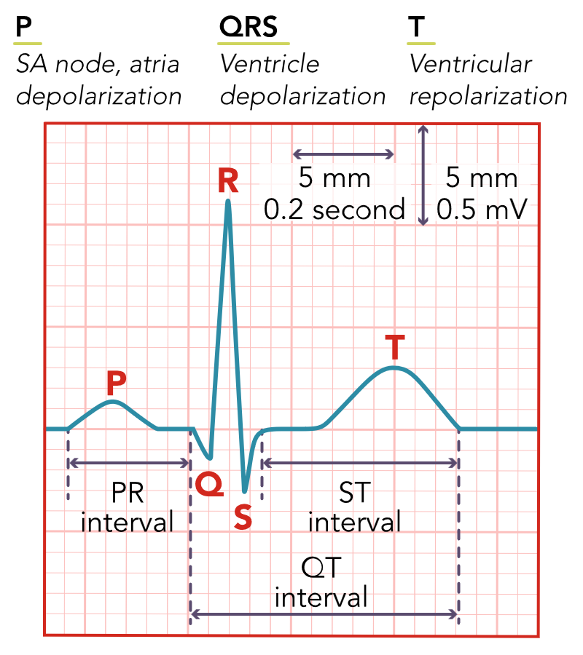
Cardiac Rhythms (2 of 5)
P wave: atrial depolarization
PR interval: related to the rate of cardiac impulse transmitted from the AV node.
QRS complex: Ventricular depolarization
ST segment: Follows ventricular depolarization and occurs prior to the start of ventricular repolarization.
T wave: Ventricular repolarization is occurring
QT interval: The time for ventricular repolarization to complete.
Notes:
Faculty note:
The waveforms identified on an ECG during a cardiac cycle are labeled alphabetically. The electrical cycle begins with the P wave.
Depolarization is transmission of the electrical impulse that activates a contraction of the heart.
Repolarization occurs when the heart relaxes and prepares to receive the next electrical impulse.

Slide 20
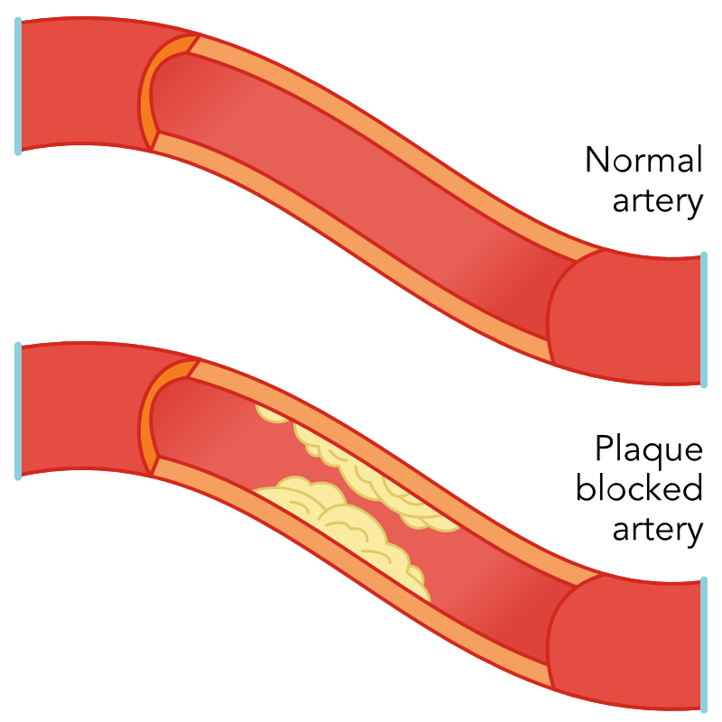
Coronary Artery Disease (CAD)
Occurs with a build up of plaque within the coronary arteries.
  Stable angina
  ST Elevation myocardial infarction (STEMI)
  Non-ST elevation myocardial infarction (NSTEMI)
  Unstable angina
Notes:
Faculty note:
Coronary Artery Disease is a broad term and involves the arteries that supply blood to the heart leading to both chronic and stable angina and acute coronary syndromes such as ST elevation myocardial infarction (STEMI), non-ST elevation myocardial infarction (NSTEMI) and unstable angina. Atherosclerosis causes narrowing or occlusion of the arteries. Plaque formation occurs in everyone starting in childhood and continues throughout adulthood. Decreased blood flow from the narrowed or occluded arteries leads to decreased oxygenation and perfusion to the myocardium. The plaque may become significant enough that not enough blood, oxygen, and nutrients reach the hear muscle during times of increased demand, such as exercise, and manifestations of angina occur. As the demand for oxygen decreases the manifestations usually will subside. If the artery becomes significantly narrowed, the heart will become ischemic leading to angina at rest (unstable angina) or MI.

Slide 21
Coronary Artery Disease: Angina
Stable Angina
  Chest pain that occurs when the heart requires more oxygen than it usually does (such as during exercise).
Treatment
  Rest
  Nitroglycerin
Acute Coronary Syndrome
  STEMI
    Due to an abrupt disruption of blood flow to an area of the heart.
  NSTEMI
    Similar characteristics of unstable angina except cardiac markers are elevated with NSTEMI
  Unstable Angina
    Angina at rest

Slide 22
Coronary Artery Disease: Risk Factors
Sedentary lifestyle
Sex
Family history
Lack of sleep
Hypertension
Diabetes
Race/ethnicity
Homocysteine levels
Lipid levels
Family history
Smoking
Obesity
Stress
Age
Notes:
Faculty note:
CAD begins in childhood therefore prevention and reduction of modifiable risk factors are key in decreasing the progression of CAD. Clients need to be educated on and know the risk factors for developing CAD and heart disease at an early age.

Slide 23
Risk Factors: Discussion Question
Which coronary artery disease risk factors are modifiable, and which are nonmodifiable?
What other chronic diseases increase the risk of coronary artery disease?
Notes:
Faculty note:
Nonmodifiable: age; sex; family history; race/ethnicity
Modifiable: inactivity; poor sleep; tobacco use; obesity; lipid levels; hypertension; diabetes; stress; homocysteine levels
Chronic diseases: hyperlipidemia; thyroid disease; depression; joint pain; BMI of 30 or greater; gout;; osteoarthritis; cancer

Slide 24
Coronary Artery Disease:
Impact on Overall Health
Plaque narrows the arteries and blocks the flow of blood to the heart.
  Client can experience chest pain or a myocardial infarction (MI)
  Overtime the heart can weaken leading to heart failure and arrhythmias.
    Mental health disorders can influence cardiac health and contribute to cardiac disorders.
Notes:
Faculty note:
Mental health: depression, anxiety, stress, PTSDD influence cardiac health after a cardiac incident but also can contribute to the development of cardiac disorders. Clients who have experienced a MI can develop depression, anxiety, and stress due to pain, fear of dying or becoming disabled, or associated financial difficulties due to the event. Anxiety and depression can lead a client to develop lifestyle behaviors, such as inactivity, smoking, or non-compliance with medications, that can lead to increasing risk factors of developing CAD and other cardiac disorders.

Slide 25
Coronary Artery Disease: Clinical Presentation
Initially CAD is asymptomatic
Manifestations appear when there is decreased blood flow and oxygen to the heart.
Most common complaint is angina
  Tightness
  Fullness
  Pressure in midsternal area
  Pain radiating to left arm, neck, jaw or back
  Pain associated with activity (stable angina)
  Pain at rest (unstable angina)
Female clients, older clients, and clients with diabetes experiencing an MI may not have chest pain or the chest pain can be atypical.
Notes:
Faculty note:
Clients having an MI may also experience diaphoresis, dizziness, nausea, vomiting, shortness of breath, lightheadedness and weakness.
Female clients may present with extreme fatigue, dizziness, abdominal pain, nausea, and pressure in the chest.
Clients with diabetes usually experience pain that is less severe than a non-diabetic client and can occur in atypical locations such as the right side of the chest, epigastric region or the back of the neck. They may also experience no pain at all.
Older adults (over age 85) may present with no chest pain but have nausea and vomiting, shortness of breath, profuse sweating, and syncope.
Older adults and diabetic clients may have difficulty interpreting their pain due to nerve damage.

Slide 26
Coronary Artery Disease: Discussion Question
Identify 3 top priorities when caring for a client with coronary artery disease.
Based on the identified priorities what nursing interventions will aid in meeting a favorable outcome for the client?
Notes:
Faculty note:
Add any notes faculty might need to lead this activity

Slide 27
Coronary Artery Disease: Lab Studies
Cholesterol
  Total Cholesterol
  Low-density lipoprotein (LDL)
  High-density lipoprotein (HDL)
Homocysteine
C-reactive protein
Cardiac Enzymes
  Troponin 1
  Troponin T
  Creatine kinase-MB (CK-MB)
Notes:
Faculty note:
The body needs cholesterol to function properly, but too much cholesterol in the blood can lead to CAD.
Total cholesterol is the overall amount of cholesterol in the blood and includes LDL and HDL.
LDL is “bad” cholesterol: it is the primary source of plaque buildup in the arteries.
HDL is “good” cholesterol: it carries cholesterol away from the arteries.
Homocysteine, is broken down into other substances the body needs by vitamin B12, vitamin B6, and folic acid, leaving very little homocysteine in the blood. Excess homocysteine can cause damage to the lining of the arteries and lead to blood clots or blockages in the blood vessels.
C-reactive protein detects inflammation in the body.
Troponin 1 and T are highly sensitive to cardiac injury and can be detected in blood serum within 4 hours from the onset of acute MI manifestations. Troponins peak in 24-48 hours and can remain elevated for days.
CK-MB is an enzyme specific to the heart muscle. After an MI, CK-MB can be detected within 4 hours and beaks by 24 hours. It returns to normal within 48 to 72 hours and can be useful in detecting re-infarction in clients.

Slide 28
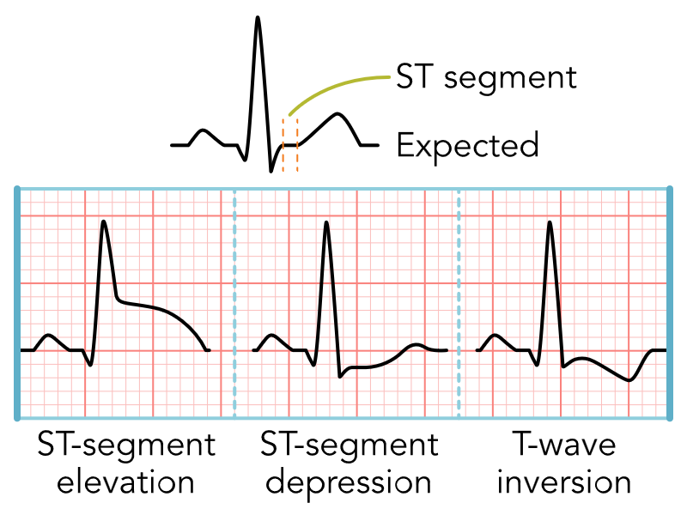
Coronary Artery Disease: Diagnostic Studies
(1 of 2)
Electrocardiogram
  ST segment elevation in 2 adjoining leads
  ST depression or T wave inversion in 2 adjoining leads
Notes:
Faculty note:
ECG Interpretation: changes that suggest coronary artery occlusion include ST segment elevation, ST depression, or T wave inversion.

Slide 29
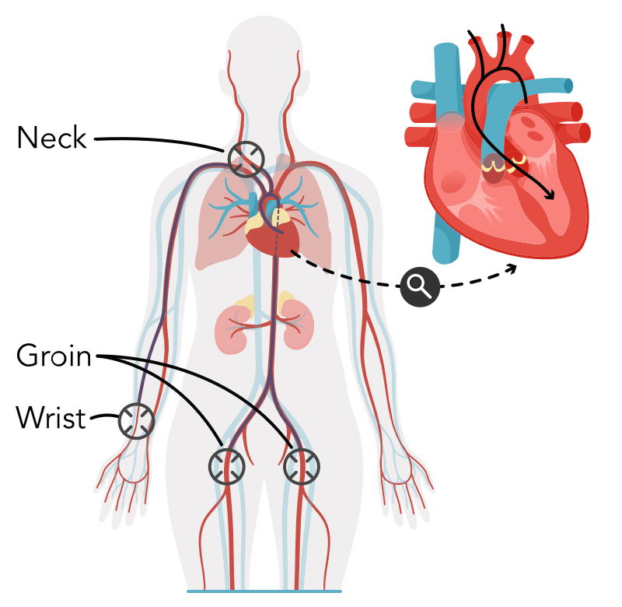
Coronary Artery Disease: Diagnostic Studies
(2 of 2)
Cardiac Catheterization
Stress Tests
  Exercise Stress Test
  Stress Echocardiogram
  Nuclear Stress Test
X-Ray
Notes:
Faculty note:
Cardiac Catheterization is the gold standard for evaluating CAD and treating blockages. A thin flexible sheath is guided into a large blood vessel in the groin, arm, or neck and threaded up to the left or right side of the heart. Contrast material is injected into the catheter and photos are taken as the contrast moves through the chambers of the heart, the valves, and major vessels of the heart.
Stress tests are preformed to evaluate how well the heart functions with activity, diagnose CAD and arrhythmias, evaluate treatment, and determine the risk for having an MI.
X-Ray Cannot detect an MI, but can detect enlargement of the heart, fluid in the lungs, and any structural abnormalities.

Slide 30
Coronary Artery Disease: Role of the Nurse
Obtain complete history and physical
  What are the client’s lifestyle habits?
    Sedentary or active
  What is the client’s occupation?
    Stress
    Exposure to radiation or toxins
    Irregular shifts and hours
  What other health conditions impact the client?
  Is there a family history of CAD?
  What medications is the client taking?
  Evaluate social determinants of health.
    Socioeconomic status
    Environment where they live and work
Educate client on risk factors
  Weight
  Diet
  Sedentary lifestyle
  Smoking
  Hypertension
  Hyperlipidemia
  Diabetes

Slide 31
Coronary Artery Disease: Nursing Process
(1 of 2)
Recognize Cues (Assessment)
  Recognize early manifestations of CAD
  Assess for risk factors
  History of chest pain
    At rest or with activity
    Does it radiate to jaw, neck, back or left arm
    What aggravates the pain
    What relieves the pain
    Syncope
    Palpitations
    Shortness of breath
    Nausea or vomiting
    Diaphoresis
    Edema
Focused assessment
  Inspection and palpation of client’s chest
  Auscultation of the heart and lungs
  Overall appearance
  Manifestations of acute distress
  Color of skin
  Diaphoresis
  Dyspnea
  Restlessness
  Confusion
  Vital signs
    BP in both arms
    Quality of the pulse
Notes:
Faculty note:
Obtain BP readings in both arms, documenting differences in the two. The arm with the higher BP is used for diagnostic and treatment purposes.
Heartrate should be measured by feeling for a pulsation over an artery and auscultating the apical pulse. Detect any differences in the strength of the heartbeat and any arrhythmias or pulse deficits.
Apical pulse is best heard at the 5th intercostal space, at the left midclavicular line. Listen for regularity in S1 and S2. Note presence of murmurs and extra heart sounds S3 and S4.
Auscultate the lungs: is there a presence of crackles (may indicate heart failure)
Inspect color of the nailbeds, capillary refill time, jugular vein distention, and peripheral edema.

Slide 32
Coronary Artery Disease: Nursing Process
(2 of 2)
Analyze Cues (Analysis)
  Clinical presentation of the client
  ECG
  Cardiac laboratory workup
Prioritize Hypotheses (Analysis)
  Time is muscle!
  Goal is to achieve reperfusion of the heart and return of blood flow.
Generate Solutions (Planning)
  Provide pain relief
  Increase blood flow to the heart muscle
Take Actions (Implementation)
  Thorough family and client history
  Cardiac monitor
  12-lead ECG
  Lab tests
  Start IV
  Medication administration
  Frequent vital signs
  Assess for complications
Evaluate Outcomes (Evaluation)
  Improved
  Worsened
  No Change
Notes:
Faculty note:
Recognize any indications that perfusion and oxygenation are inadequate, such as unrelieved chest pain, restlessness, and change in level of consciousness.
Look for abnormalities in lab values, such as elevated troponins, and ass any elevation in the ST segment on the ECG.
Clients with elevated troponins or ECG changes should initially take 150-300 mg of aspirin
2 large gauge IVs should be initiated
Single dose IV heparin followed by a continuous heparin infusion
Antiplatelet therapy with Ticagrelor or clopidogrel by mouth is recommended.
Treat pain: morphine, fentanyl, nitroglycerine
For STEMI an emergent heart catheterization and percutaneous intervention with a door to procedure time of 90 minutes or less. If there is no percutaneous intervention available or the client cannot be transferred to a cath lab within 120 minutes or less, thrombolytics are recommended.
For NSTEMI or unstable angina, control of symptoms is the first priority along with aspirin and heparin.
In all cases beta blockers, statins, and an angiotensin-converting enzyme (ACE) inhibitor should be started as soon as possible.
If the client is not responsive to percutaneous intervention, they are then either transferred to surgery for coronary artery bypass grafting (CABG) or treated medically.

Slide 33
Coronary Artery Disease:
Treatments and Therapies
Healthy lifestyle changes
  Smoking cessation
  Heart-healthy diet
  Maintain a healthy weight
  Physical activity
  7-9 hours of quality sleep
Angioplasty
Coronary Artery Bypass Graft
Medications
  ACE Inhibitors
  Beta Blockers
  Calcium Channel Blockers
  Nitrates
  Statins
  Non-Statins
  Thrombolytics
  Antiplatelet Agents
  Anticoagulants

Slide 34
Heart Failure: Pathophysiology
Heart is not able to meet the demands of the systemic circulatory system
Ventricles do not fill properly
Blood is not ejected into the systemic circulatory system properly
Notes:
Faculty note:
Hypertension, CAD, uncontrolled arrhythmias, MI, diabetes and valve disease contribute to heart failure.

Slide 35
Heart Failure: Risk Factors
Family history of heart disease
Chronic pulmonary disease
CAD
Hypertension
Chronic infection
Diabetes
Obesity
Metabolic disease
Alcohol abuse
Cardiotoxic agents
Notes:
Faculty note:
More than half of the clients who have heart failure also have a comorbid condition
Heart failure has a high mortality and morbidity rate. The prevalence increases with age.

Slide 36
Heart Failure: Impact on Overall Health
Manifestations of heart failure impact client’s ability to carry out ADLs
  Shortness of breath
  Fatigue
  Weakness
  Difficulty sleeping
  Edema
  Depression
  hopelessness
Safety Considerations
  Self monitor manifestations
  Proper administration of oxygen (if needed)
Education on reducing modifiable risk factors
  When to report manifestations

Slide 37
Heart Failure: Clinical Presentation
Left-sided heart failure
  JVD
  Shortness of breath
  Hypotension
  Tachycardia
  Orthopnea
  Exertional or paroxysmal nocturnal dyspnea
  Edema in lower extremities
  Weight gain
  Increased abdominal girth
  Pulmonary congestion
Right-sided heart failure
  JVD
  Shortness of breath
  Chest discomfort
  S3 murmurs
  Palpitations
  Ascites
  Peripheral edema
  Enlarged liver and spleen
Biventricular heart failure
  Manifestations of both right and left sided heart failure
Notes:
Faculty note:
Manifestations of heart failure largely depend on which side of the heart is affected.

Slide 38
Heart Failure: Lab and Diagnostic Studies
Framingham Diagnostic Criteria of Heart Failure
New York Heart Association Classification of Severity of Heart Failure
Blood tests
  BNP
Cardiac Catheterization
Echocardiogram
Chest X-ray
Notes:
Faculty note:
Framingham Diagnostic Criteria and NY Heart Association Classification are tools used to diagnose and grade heart failure.
Blood tests: BNP: used to determine if the dyspnea the client is presenting with is cardiac related or noncardiac. BNP is also useful to monitor effectiveness of treatment. BNP and NYHA classification system are strong predictors of readmission and risk of death.
Cardiac Catheterization can reduce the manifestations of heart failure by decreasing the damage caused by an MI.
Echocardiogram: beneficial in the diagnosis of heart failure as it assesses both systolic and diastolic dysfunction and identifies abnormalities in wall motion or the function of the heart valves.
Chest X-Ray: assess the size of the heart and the degree of pulmonary congestion.

Slide 39
Heart Failure: Role of the Nurse
Assess client’s ability to perform ADLs
Educate client on the safe use of oxygen
Awareness of worsening manifestations
Medication safety and compliance
Dietary teaching
Obtain daily weights

Slide 40
Heart Failure: Nursing Process (1 of 2)
Recognize Cues (Assessment)
  Health history
  Lung sounds
  Heart sounds
  Manifestations of fluid overload
  Lab results
Analyze Cues (Analysis)
  Analyze data that indicates worsening manifestations
    Weight gain
    Decreased ability to perform ADLs
    Edema
    Rales in lungs
Prioritize Hypotheses (Analysis)
  Reduce fluid overload
  Improve respiratory and cardiac status
Generate Solutions (Planning)
  Educate the client on controlling and monitoring manifestations
  Adhere to medication regime
  Adhere to diet
  Track daily weights
  Goal to improve quality of life and reduce morbidity and mortality
Notes:
Faculty note:
Diagnosis of heart failure relies heavily on an accurate and thorough physical assessment.

Slide 41
Heart Failure: Nursing Process (2 of 2)
Take Actions (Implementation)
  Elevate the head of bed to high fowler’s position
  Apply oxygen as ordered
  Anxiety relieving techniques
  Cough and deep breath exercises
  Assess lung sounds
  Medication administration
  Lifestyle modifications
Evaluate Outcomes (Evaluation)
  Improved
  Worsened
  Stay the same

Slide 42
Heart Failure: Treatment and Therapies
Nonpharmacological interventions
  Smoking cessation
  Weight reduction
  Monitoring fluid intake
  Use alcohol and caffeine in moderation
  Consume a heart healthy diet
  Physical activity
  Stress management
  Blood pressure control
Pharmacologic interventions
  ACE inhibitors
  Angiotensin II Receptor Blockers
  Angiotensin-Receptor Neprllysin Inhibitors
  Beta Blockers
  Aldosterone Antagonists
  Hydralazine and Isosorbide dinitrate
  Diuretics
Surgical interventions
  Cardiac Catheterization
  Implantable Cardioverter Defibrillator
  Biventricular Pacemaker
Notes:
Faculty note:
Treatment will depend on correcting the underlying cause and relieving manifestations, slowing the progression of the disease, and improving quality of life.

Slide 43
Peripheral Vascular Disease: Pathophysiology
Peripheral vascular disease describes progressive conditions characterized by altered blood flow through vessels outside of the heart.
  Peripheral Venous Disease (PVD)
  Peripheral Artery Disease (PAD)
  Chronic Venous Disease (CVD
    Conditions in the lower extremities
    Blood pools in the legs
  Chronic Venous Insufficiency (CVI)
    Constant increased venous pressure caused by improperly working venous valves or obstruction.
  Venous Thrombosis
    Virchow triad
      Injury or changes to the wall of the vein
      Abnormalities in the blood clotting components
      Blood flow within the vein has slowed or stopped

Slide 44
Peripheral Venous Disease: Risk Factors
Abnormal structure in the veins
Functional abnormalities that lead to venous reflux
Valvular incompetency
Genetics
Progesterone
Family history
Obesity
Smoking
Pregnancy
History of thrombosis
Clinical, Etiology, Anatomy and Pathophysiology (CEAP) tool.
  Clinical manifestations of CVD
  Etiology of CVD
    Primary
    Secondary
    Congenital
  Anatomy of where CVD is located
  Pathophysiology of the CVD
Notes:
Faculty note:
The CEAP tools is used to diagnose CVD and to categorize and assess the severity of it.

Slide 45
Peripheral Venous Disease:
Impact on Overall Health
Impaired quality of life
Frequent visits to the health care provider
Limited employment opportunities
Emotional health affected
Age increases risk

Slide 46
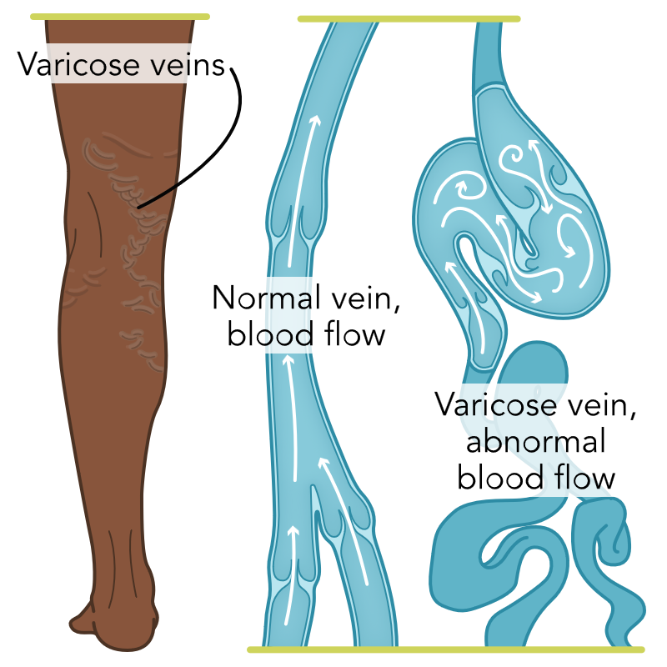
Peripheral Venous Disease:
Clinical Presentation
Varicose veins
Brown pigmentation around the ankles
Edema
Pruritus
Open sores
Restless legs
Feeling heaviness in lower extremities

Slide 47
Peripheral Venous Disease
Lab and Diagnostic Testing
  Plethysmography
  Duplex Ultrasound
Role of the Nurse
  Safety: Client may have an unsteady gait. Assess for a mobility aid.
  Educate the client on how to control or decrease manifestations.
    Edema
    Venous ulcers
    Hemorrhage
    Phlebitis
    Deep vein thrombosis
  Obtain a thorough history
  Thorough assessment of lower extremities.
Notes:
Faculty note:
Plethysmography is used to measure changes in the blood volume in the lower extremities.
Duplex Ultrasound uses sound waves to produce images of a vessel to assess the competency of the vascular system. It shows the size of the vessel, the direction of blood flow, and severity of any reflux

Slide 48
Peripheral Venous Disease: Nursing Process
Recognize Cues (Assessment)
  Obtain thorough history and physical
  Identify risk factors
  History of leg pain
  Client occupation
Analyze Cues (Analysis)
  Differentiate between venous and arterial abnormalities
Prioritize Hypotheses (Analysis)
  Decrease pressure in the veins
  Decrease pain and edema
  Facilitate wound healing.
Generate Solutions (Planning)
  Decrease pain and edema
  Facilitate wound healing
Take Action (Intervention)
  Wound care
  Pain control
  Education
Evaluate Outcomes (Evaluation)
  Improved
  Worsened
  Stay the Same
Notes:
Faculty note:
Physical assessment should include a comprehensive exam of the lower extremities. The nurse should assess pulse, temperature, and color of the extremities and note any wounds, edema, stasis dermatitis, or lipodermatosclerosis.

Slide 49
Peripheral Venous Disease:
Treatments and Therapies
Elevation of legs
Exercise
Compression therapy
Vein-Stripping
Ultrasound-guided foam sclerotherapy
Radiofrequency and laser ablation
Medication therapy
  Flavonoids anti-inflammatory
  Pentoxifylline (Trental) hemorheologic agent
  Acetylsalicylic acid (Aspirin) non-steroidal-anti-inflammatory
  Saponins anti-inflammatory
Notes:
Faculty note:
Client should elevate their legs above the heart three to four times a day for 30 minutes. They should also remain active and engage in activities that cause the calf muscle to pump, such as ankle pumps.
Compression therapy: compression stockings, layered wraps, and intermittent pneumatic compression pump
Vein stripping: Diseased vein is removed.
Ultrasound guided foam sclerotherapy disease vein is accessed with a catheter. A foaming agent is injected and causes the vein to scar, forcing the blood to reroute to healthier veins.
Radiofrequency and laser ablations: thermal energy is used to cause the wall of the vein to become damaged and contract sealing the vein so that it is no longer functional. The body reabsorbs the vein and blood flow is rerouted through a healthier vein.
Medications are used to affect vascular permeability, tone of veins, alleviate the inflammatory response, and act on platelet aggregation.

Slide 50
Peripheral Artery Disease: Pathophysiology
Progressive disorder that affects blood flow to the arteries in the lower extremities.
The most common cause is atherosclerosis.
Notes:
Faculty note:
Plaque builds up in the artery walls and causes decreased blood flow, blockage, or spasms, which affects the ability of the body to supply tissues with oxygen rich blood.

Slide 51
Peripheral Artery Disease: Risk Factors
Atherosclerosis
Injury to the lower extremities
Inflammation of the blood vessels
Radiation exposure
Embolism or thrombosis
Vasospasm
Hypertension
BMI greater than30
Diabetes
Hypercholesterolemia
Elevated homocysteine levels
Aging
Smoking
Family history of Cardiovascular Disease

Slide 52
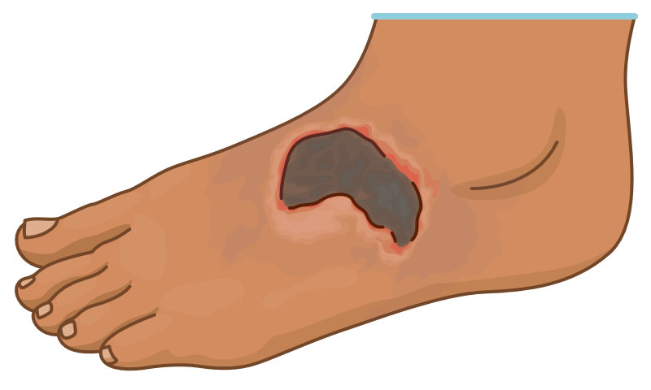
Peripheral Artery Disease:
Impact on Overall Health
Discomfort
Weakness
Cramping in feet, legs, hips
Decline in physical activity
Anxiety
Stress
Depression
Neuropathy
Ulcerations of the foot
Increased risk of falls

Slide 53
Peripheral Artery Disease:
Clinical Presentation
Intermittent claudication
Slow toenail growth
Decreased hair growth on lower extremities
Wounds on toes or foot
Skin with pale shiny appearance
Diminished or absent pulses in the lower extremities

Slide 54
Peripheral Artery Disease:
Lab and Diagnostic Testing
Ankle-Brachial Index
Duplex Ultrasonography
Computed Tomographic Angiography
Magnetic Resonance Angiography
Peripheral Angiogram
Notes:
Faculty note:
The photo is of an ankle-brachial index. ABI confirms the assessment finding of decreased or absent pulses in the lower extremities. The ABI measures the ankle systolic pressure ratio and compares it to the brachial systolic pressure.
Computerized tomographic angiography uses contrast dye through and IV and then X-rays to visualize the arteries.
MRAA used to obtain cross sectional images of the arteries.

Slide 55
Peripheral Artery Disease: Role of the Nurse
Assess for the manifestations of acute limb ischemia (6 Ps)
  Pallor
  Pain
  Paresthesia
  Paralysis
  Pulselessness
  Poikilothermia
If client is scheduled for angiogram question the client regarding allergies to shellfish or iodine.
Client education
  Risk factor modification
  Management of the manifestations of the disease
  Recognizing manifestations
  Compliance with treatment
Notes:
Faculty note:
Poikilothermia: inability to regulate own body temperature

Slide 56
Peripheral Artery Disease: Nursing Process
(1 of 2)
Recognize Cues (Assessment)
  Obtain history
    Risk factors
  Assess
    Pain
    Lower extremity pulses, capillary refill, temperature, color
    Wound presence
    Edema
    Auscultate for bruits over major vessels
Analyze Cues (Analysis)
  Are pulses decreased or absent?
  Is there atrophy of the lower extremity muscles?
  Is skin cool to palpate?
  Is there increased pallor and pain when lower extremities are elevated?
  Is there redness and decreased pain when extremity is dependent?
  Is there pain on palpation?

Slide 57
Peripheral Artery Disease: Nursing Process
(2 of 2)
Prioritize Hypotheses (Analysis)
  Aggressive modification of risk factors
  Improve quality of life
  Promote long-term survival
Generate Solutions (Planning)
  Interventions to improve outcomes.
  Modification of risk factors
  Education on treatment and compliance
  Timely recognition of emergencies
Take Actions (Implementation)
  Lifestyle modifications to reduce risk
  Client education
    Surgical interventions
    Prescribed medications
Evaluate Outcomes (Evaluation)
  Improved
  Worsened
  Stay the same

Slide 58
Peripheral Artery Disease:
Discussion Question
In small groups
  Describe the difference between peripheral venous disease (PVD) and peripheral artery disease (PAD).
  What is your priority when caring for a client with PVD?
  What is your priority when caring for a client with PAD?
  Identify 2 priority interventions each for PVD and PAD.
  What is your rationale for choosing those priorities?
  What signs would indicate to the nurse that the client outcomes have been met?
Notes:
Faculty note:
Add any notes faculty might need to lead this activity

Slide 59
Clinical Judgment Question
Based on the priority problem that you chose, what nursing interventions will aid in meeting a favorable outcome for the client?
What nursing interventions will you implement to avoid complications?
Notes:
Faculty note:
Add any notes faculty might need to lead this activity

Slide 60
Case Study (1 of 3)
A 76-year-old client was admitted to the ED with reports of lightheadedness, fatigue, and chest palpitations. The client reports history of Type 2 diabetes (treated with metformin), recent lower GI bleed, hypercholesterolemia, and hypertension. ECG rhythm strip shows rapid atrial fibrillation. Non-productive, persistent dry cough. Lungs sounds with rales in the bases bilaterally. Shortness of breath with exertion. The client is pale, warm and dry, oriented X4, reports nervousness. The client reports last BM was this am with no evidence of frank blood. Voiding with no difficulty. Poor appetite over the last 2+ edema to the lower extremities. No nausea or vomiting. Did not take daily meds today.
Vital Signs: Temp 99.4F (oral); P 168 irregular; RR 24, BP 86/54; oxygen saturation 90% on room air. Denies pain.
Labs: Glucose 194 mg/dL; Na 142 mEq/L; K 4.1 mEq/L; Cl 98 mmol/L; Ca 9.1 mg/dL; BUN 10 mg/dL; CRE 1.1 mg/dL; Hgb 10.7 g/dL; HCT 34%; PLT 250,000/mL; WBC 7250/mL; BNP 522 pg/mL
ECG: Rapid atrial fibrillation. Heart rate 168.
Chest X-ray: Bilateral pleural effusions and cardiomegaly
Admitting Diagnosis: Rapid atrial fibrillation, left-sided heart failure
Notes:
Faculty note: Download the blank concept map PDF to share with students for this activity.
Activity Instructions
Have students review the initial clinical scenario (covered in two slides) and complete the concept map. Then use questions below to drive discussion about the scenario.
Recognize Cues - What are the relevant information is related to this clients condition? What additional data is needed to identify the nursing priorities?
Analyze Cues - What potential complications is the client at risk for if the atrial fibrillation does not resolve?
What are the physiological aspects contributing to the diagnosis of atrial fibrillation and left-sided heart failure?
What lab findings are most significant for this client?
Prioritize Hypotheses - What are the problems impacting the client?
Prioritize the problems by order of importance and identify what data you used to support your decision on choosing which client problem is the priority.
What priority setting framework did you use to determine the client’s priority problem?
What possible complications could the client experience based on the identified problems?
Generate Solutions - Based on the priority problem that you chose, what nursing interventions will aid in meeting a favorable outcome for the client?
What nursing interventions will you implement to avoid complications?
Take Actions - What information will you include in your client education plan?
What members of the healthcare team will be essential in helping you care for this client? What is your rationale for choosing those members of the healthcare team?
Review the provider orders. What is the rationale for each order? Prioritize the order in which you will carry out the provider orders. What is your rationale for how you prioritized your nursing interventions?

Slide 61
Case Study (2 of 3)
Orders:
12 lead ECG; telemetry
Strict I & O
Daily weights
Echocardiogram
ADA/Cardiac 2 GM Sodium diet
Restrict fluids to 1.2L/24 hours.
Regular Sliding Scale Insulin before meals and at bedtime
Blood sugar <70 hypoglycemic protocol, BS 70-130 no insulin; BS 131-180 4 Units regular insulin SQ, BS 181-240 8 Units regular insulin SQ, BS 241-300 10 Units regular insulin SQ, BS 301-350 12 Units regular insulin SQ, BS 351-400 16 Units regular insulin SQ, BS >400 20 Units regular insulin and notify the provider.
CKMB, Troponin I and PTT now.
Carvedilol 3.125 mg by mouth twice daily.
Diltiazem 0.25mg/kg IV bolus X1 then start IV drip at 5mg/hour, may titrate up to 15mg/hour to keep HR<100.
Heparin 60 units/kg IV loading dose then 12units/kg/hour IV.
Furosemide 20mg by mouth every 12 hours.

Slide 62
Case Study (3 of 3)
24 hours after admission the client’s weight was 71kg. Client is tolerating the ADA/Cardiac diet. Blood sugars have ranged from 142-194. Client reports dry mouth. Telemetry shows atrial fibrillation with heart rate in the 80s. Lungs have fine crackles in left lower lobe. ECHO revealed ejection fraction of 56%. Heparin is infusing at 17 mL/hour (concentration 25,000 units Heparin in 250 mL normal saline). Diltiazem is infusing at 7 mg/hour to keep heart rate <100 and SBP > 90). (Concentration 125 mg/125 mL D5W).
Vital signs: Temp: 36.2 C orally; P 84; RR 16; BP 132/56; O2 Sat 97% room air.
Labs: Labs: Glucose 194 mg/dL; Na 136 mEq/L; K 3.6 mEq/L; Cl 98 mmol/L; Ca 8.9 mg/dL; BUN 10 mg/dL; CRE 1.1 mg/dL; Hgb 9.9 g/dL; HCT 32%; PLT 250,000/mL; WBC 7250/mL; BNP 515 pg/mL; PTT 70 sec, CKMB 2.0 u/L, Troponin I 0.02 ng/mL
Notes:
Faculty note:
Activity Instructions
Review the unfolding clinical scenario information and discuss.
Evaluate Outcomes -
Explain whether the client met the expected outcomes.
Determine whether you will need to revise the plan of care. If yes, describe how the plan of care should be modified.
How many drops per minute are the Heparin and Diltiazem infusions set?
What information do you need to evaluate outcomes?

Slide 63
Self-Reflection Activity
Complete the following questions and submit them to your instructor.
  The effects of stress on a person’s health can be devastating. In the midst of the stress of caring for a client with a cardiovascular emergency, what can you do to maintain your own composure, and reduce the stress your clients and their families experience?
  A new diagnosis of cardiac arrhythmia could be very frightening for a client. What could you (as the nurse) say or do to reduce the client and family’s anxiety related to the diagnosis? How would your response differ for a client experiencing atrial flutter vs a client experiencing ventricular tachycardia?
  This lesson focused on clients with alterations in cardiovascular function and perfusion. Reflect on how you may handle caring for a client who is newly diagnosed with heart failure. What nonpharmacologic interventions could you do to optimize the client’s comfort?
Notes:
Faculty note:
Faculty can choose one or all of these self-reflection questions for learners.
Additional opportunity is for learners to discuss the self-reflection in small groups.

Slide 64
Lesson Reflection Questions
Complete the following questions and submit them to your instructor.
  How would you approach caring for a client experiencing a cardiovascular and/or perfusion emergency? How would approach to care differ for clients of various ages, cultures, etc.?
  What do you feel is your most important role in caring for clients with cardiovascular disease?
  What unexpected information did you uncover about clients experiencing alterations in cardiovascular function and perfusion? Why did it surprise you?
  Describe three ways your nursing skills and knowledge improved after completing this lesson.
  What additional questions do you have after completing this lesson?
Notes:
Faculty note:
These questions provide an overview of the lesson.
Could be used during class or as separate assignment.

